Slide 1

CSE491
Lecture- 14
OpenStack Components
https://www.openstack.org/

Slide 2
Overview of OpenStack architecture
Consists of eleven dedicated components
Each of these components are dedicated for different OpenStack services
Keystone(Authorization & Authentication) | 2. Glance(Instance launch) | 3. Nova(Compute domain)
4. Neutron(Networking) | 5. Swift(Object Storage) | 6. Cinder(Block storage)
7. Horizon(Dashboard) | 8. Ceilometer(Telemetry) | 9. Heat(orchestration)
10. Trove(Database) | 11. Marconi(Messaging)

Slide 3
Keystone
(Authentication & Authorization)
Authentication service of OpenStack
Provides clients with authentication, service discovery, and distributed multi-tenant authorization
Works with token, policy, catalog, and assignment services.

Slide 4
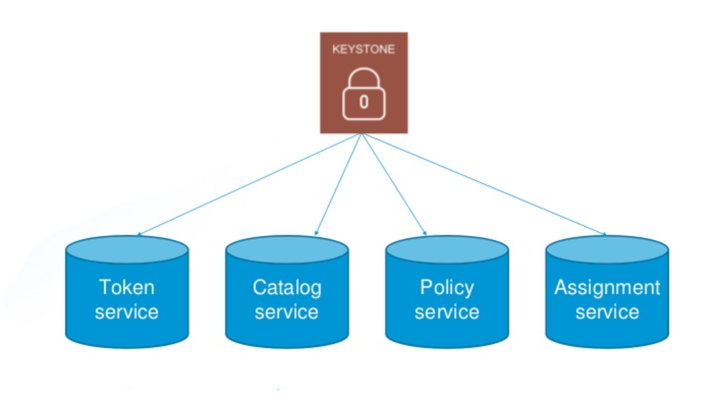
Keystone
(Authentication & Authorization)

Slide 5
Keystone
(Authentication & Authorization)
First the token service generates a token whenever an account is signed in
The catalog service allows discovery of different service for the clients to avail
Policy service checks if a user is authorized to to perform any action
Assignment service overviews the roles of the users

Slide 6
Glance
(Instance Launch)
It provides the user with the service of uploading and discovering data assets
Currently only disk images and metadata definition can be stored
Works with a restful API to store and retrieve disk images

Slide 7
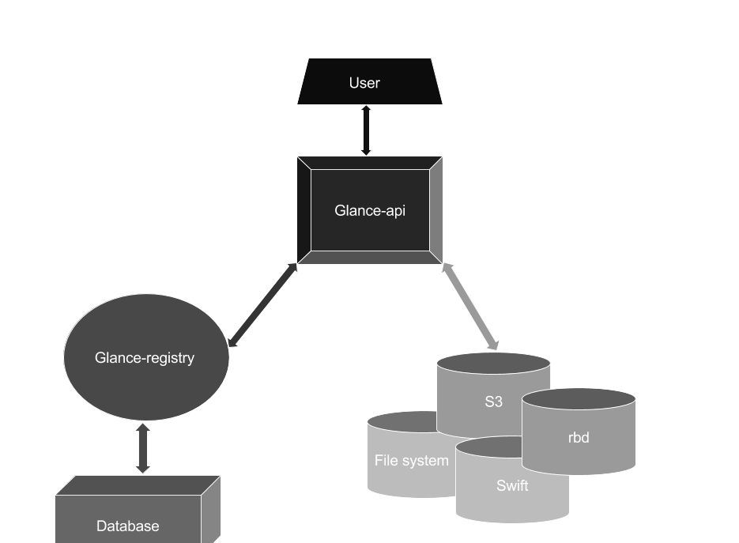
Glance
(Instance Launch)

Slide 8
Glance
(Instance Launch)
User connects through the Glance API to the registry
The registry contains each entry of the disk images
The metadata is stored in the database
The API also connects to different filesystems, the relational database, the object storage system(Swift), and the S3.

Slide 9
Nova
(Compute Domain)
This is where all the processing take place
Designed to provide a way to provision virtual machines
Fault tolerant, recoverable and provides API compatibility to different systems
Built on a messaging architecture

Slide 10
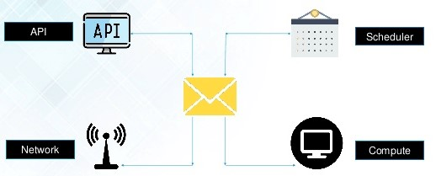
Nova
(Compute Domain)

Slide 11
Nova
(Compute Domain)
When a user makes a request, the Nova API connects to the message broker system first
The message broker system then forwards the request to the scheduler where the jobs are waiting to be executed one by one
After processing the job, the scheduler then sends it to the compute domain via the broker system
The message broker is also connected to the network via Neutron API

Slide 12
Neutron
(Networking Service)
Networking component of the OpenStack system
Delivers Networking-as-a-service to the users
Relies upon Keystone for authentication and authorization
Allows users to create their own public or private networks and subnets

Slide 13
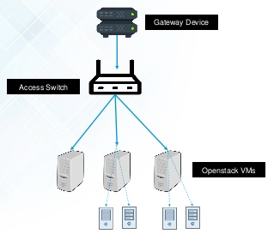
Neutron
(Networking Service)

Slide 14
Neutron
(Networking Service)
Hosts or the virtual machines are connected to the gateway device through an access switch
One of the host manages the authorization and authentication services via keystone
Connects these hosts to all the available OpenStack services

Slide 15
Swift
(Object Storage)
Widely available, distributed, and consisted object storage service
Can store all kinds of files and disk images
Everything is stored as objects
Data is stored securely and is easily retrievable
Used by different organizations such as OVH, Wikipedia, Comcast

Slide 16
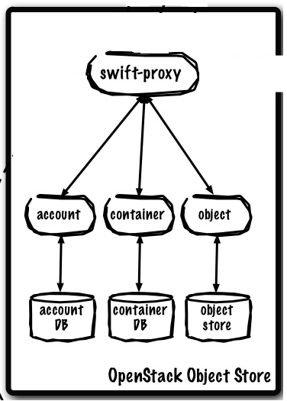
Swift
(Object Storage)

Slide 17
Swift
(Object Storage)
The architecture includes a proxy, which then includes the accounts, containers, and objects
The account with the help of account database stores the information of the users.
Account takes help of Keystone to validate access
Once a user is validated, they can access their containers to store objects.

Slide 18
Swift
(Object Storage)
Container database keeps track of the the objects via their metadata
Object is a storage server where the objects are actually stored
Objects can be retrieved, stored, and deleted from the object server

Slide 19
Cinder
(Block Storage System)
It provides the users with persistent block storage services
Where Swift acts like a hard drive of a system, Cinder acts like the pluggable external hard disk
Memory management in here is done by the user
Only one instance can be attached with each instance

Slide 20
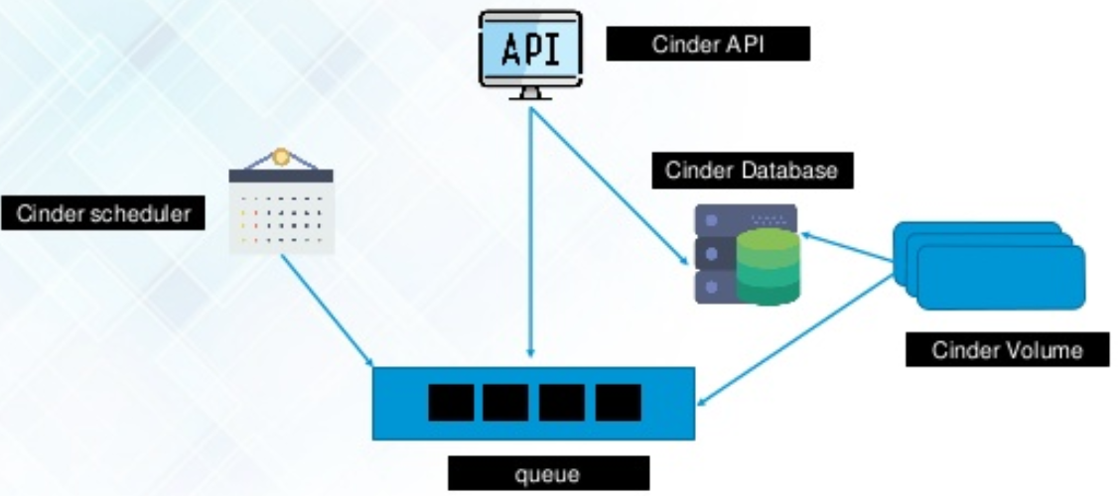
Cinder
(Block Storage System)

Slide 21
Cinder
(Block Storage System)
Cinder API is connected to a queue which is then connected to a scheduler and the volume service
API sends the user request to the queue who then forwards it to the scheduler
Scheduler then routes them to the Cinder volume
Finally the volume stores the object and gives the metadata to the database to keep track of them

Slide 22
Dashboard (Horizon)
Shows the summary of projects and resources utilized.
The dashboard depends on the role of the user that logs in.
The Dashboard service provides the Project, Admin, and Settings default dashboards
Interfaces with other products and management tools.

Slide 23
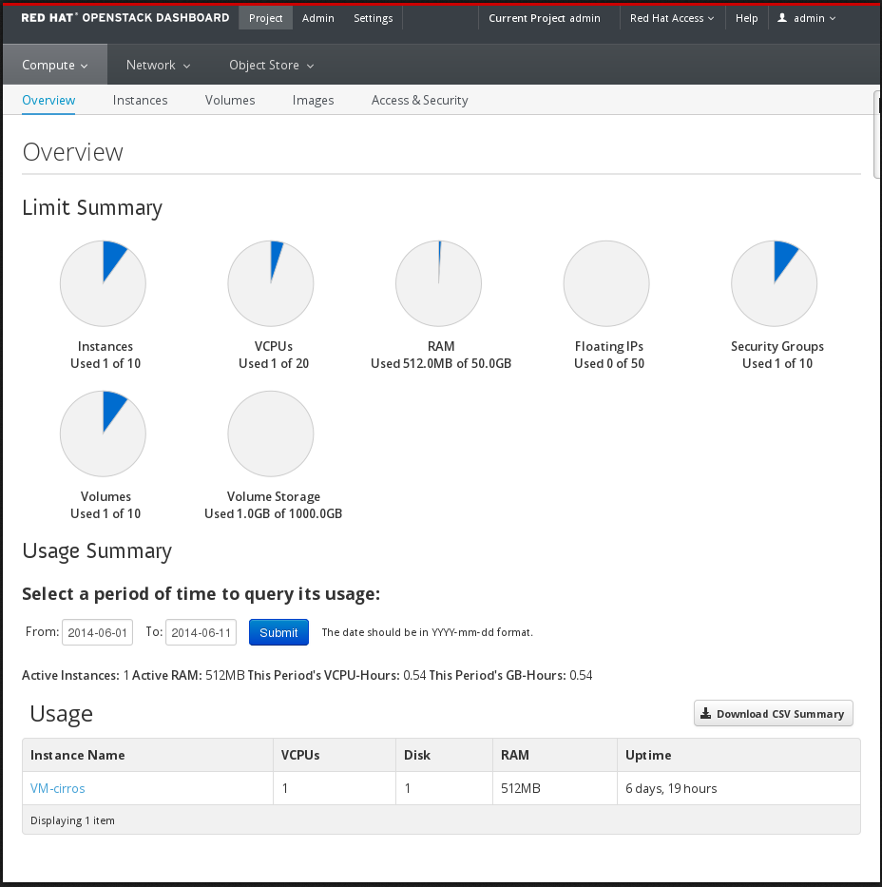
Dashboard (Horizon) UI

Slide 24
Dashboard (Horizon) Cont.
Instances can be created ,lunched .
Networking tropology can be created and added to instances.
Images can be viewed and maintained from the Dashboard.
Router can also be managed from the Dashboard.

Slide 25
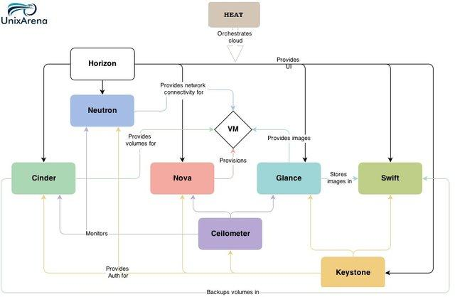
Dashboard (Horizon)

Slide 26
OpenStack Telemetry (ceilometer)
Provides users with the usage data information.
By using the usage data of Cloud Services decides the billing .
Can collect data from notifications sent from other components.
Api –server, central agent, data store service and collector agent can be deployed.

Slide 27
OpenStack Telemetry (ceilometer)Cont.
Purpose of telemetry service metering,rating,billing.
Components are polling,notification,collector.
Support kafka driver for external purposes.
Two types of stores in database Event and Metric
Event- includes start of an instance, volume attached to an instance etc
Metric- includes Cpu usage, memory usage etc.

Slide 28
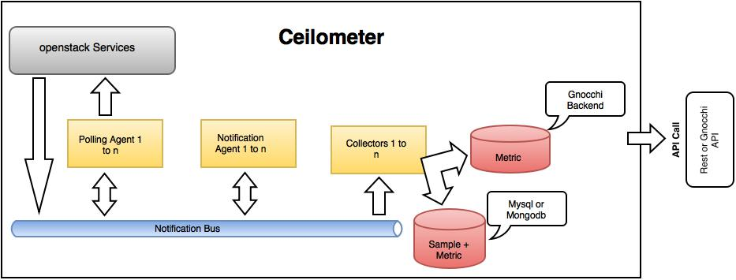
OpenStack Telemetry (ceilometer)

Slide 29
OpenStack Orchestration (heat)
Used to organize multiple composite cloud application.
Offers access to all OpenStack core services with a single modular templates as well as capabilities.
Using this component Stack, Templates, Resources and Events can be controlled.
Provides templates.
Templates are modular and resource –oriented

Slide 30
OpenStack Orchestration (heat) Cont.
Templates can be recursively defined and reused.
Resources can be auto scaled.
Allows custom resources.
Manages the life cycle of an application.
Heat orchestration purpose is to reduce IT cost.

Slide 31
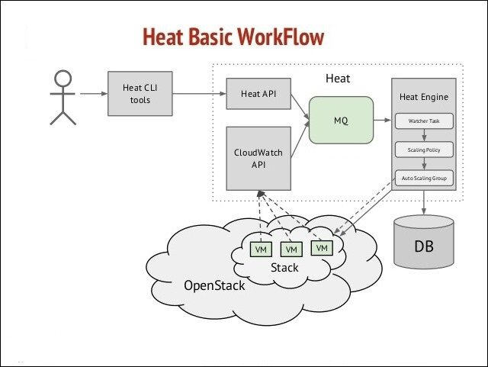
OpenStack Orchestration (heat) Cont.

Slide 32
OpenStack Database (Trove)
Database Service for OpenStack.
Designed entirely on OpenStack.
Can work with Data stores, version, instances and databases.
Contains api, task manager and a guest agent.
User / Database management

Slide 33
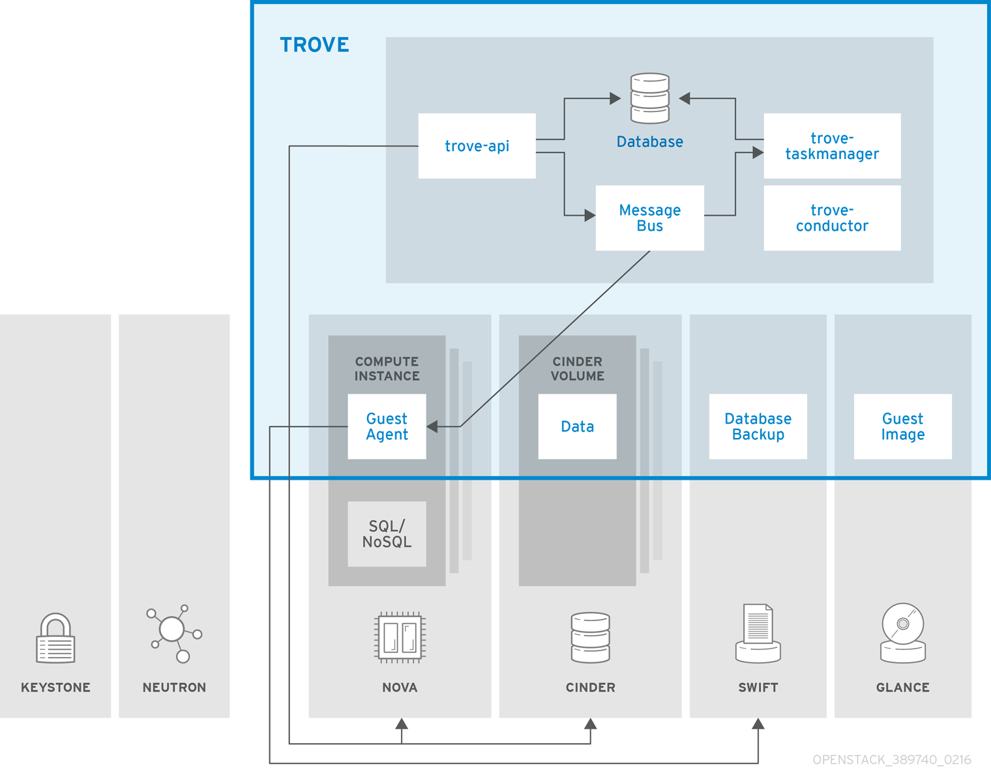
OpenStack Database (Trove) Cont.
Cloud users and administrators can manage multiple database instances .
Focuses on resource isolation while automating complex administrative tasks.
Involves continuous health monitoring for database instances.

Slide 34
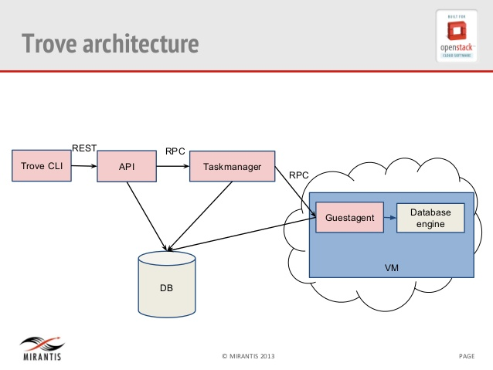
OpenStack Database (Trove) Cont.

Slide 35
Messaging as a Service (Marconi)
Queuing as a Service: queues, message, claims
An HTTP driven , mostly RESTful API
Marconi is a new OpenStack project that aim to provide applications running on OpenStack cloud an open Simple Queue Service and Simple Notification Service.
Uses a modular architecture and supports unified publish subscribers and job queuing semantics.
Users can customize it to their need

Slide 36
Acknowledged to
Fatema Ahsan Meem- 17101480
Md Rafid Mushfique- 17101167

